Slide 1
CSE 4310 – Compiler Design
CH2 – Lexical Analysis

Slide 2
Outline
Introduction – What is Lexical Analysis?
Tokens, Patterns, Lexemes
The Role of Lexical Analyzer
Lexical Analyzer versus Parsing
Specification of Tokens
Regular Expressions and Regular Definitions
Recognition of Tokens
Finite Automata and Transition Diagrams
Lex – a lexical analyzer generator

Slide 3
Introduction
Lexical analysis is the first phase of a compiler.
In this chapter you will learn about the role of Lexical Analyzer (LA) :
by understanding the terms tokens, patterns, lexemes, attributes of tokens and lexical errors.
the specification of tokens by understanding strings and languages, operations on languages, regular expressions, and regular definitions.
the generation (recognition) of tokens using finite automaton, transition diagrams – recognition of reserved words, identifiers, etc.
You will also learn about Lex – a lexical analyzer generator tool.

Slide 4
What is Lexical Analysis?
The role of the lexical analyzer is to read a sequence of characters from the source program and produce tokens to be used by the parser.
The lexical analysis phase of the compiler is often called tokenization
The lexical analyzer (LA) reads the stream of characters making up the source program and groups the characters into meaningful sequences called lexemes.

Slide 5
What is Lexical Analysis?
For each lexeme,
the lexical analyzer produces as output a token of the form <token–name, attribute–value> that it passes on to the subsequent phase, syntax analysis.
Where,
token–name is an abstract symbol that is used during syntax analysis , and
attribute-value points to an entry in the symbol table for this token.
Information from the symbol-table entry is needed for semantic analysis and code generation.

Slide 6
What is Lexical Analysis?
Example:
For example, suppose a source program contains the assignment statement
position = initial + rate * 60
The characters in this assignment could be grouped into the following lexemes and mapped into the following tokens passed on to the syntax analyzer:
position is a lexeme that would be mapped into a token <id, 1>, where id is an abstract symbol standing for identifier and 1 points to the symbol table entry for position.
The symbol-table entry for an identifier holds information about the identifier, such as its name and type.
The assignment symbol = is a lexeme that is mapped into the token <=, >.
Since this token needs no attribute-value, the second component is omitted.

Slide 7
What is Lexical Analysis?
Example:
initial is a lexeme that is mapped into the token <id, 2>, where 2 points to the symbol-table entry for initial.
+ is a lexeme that is mapped into the token <+, >.
rate is a lexeme that is mapped into the token <id, 3>, where 3 points to the symbol-table entry for rate.
* is a lexeme that is mapped into the token <*, >.
60 is a lexeme that is mapped into the token <60, >.
Blanks separating the lexemes would be discarded by the lexical analyzer.

Slide 8
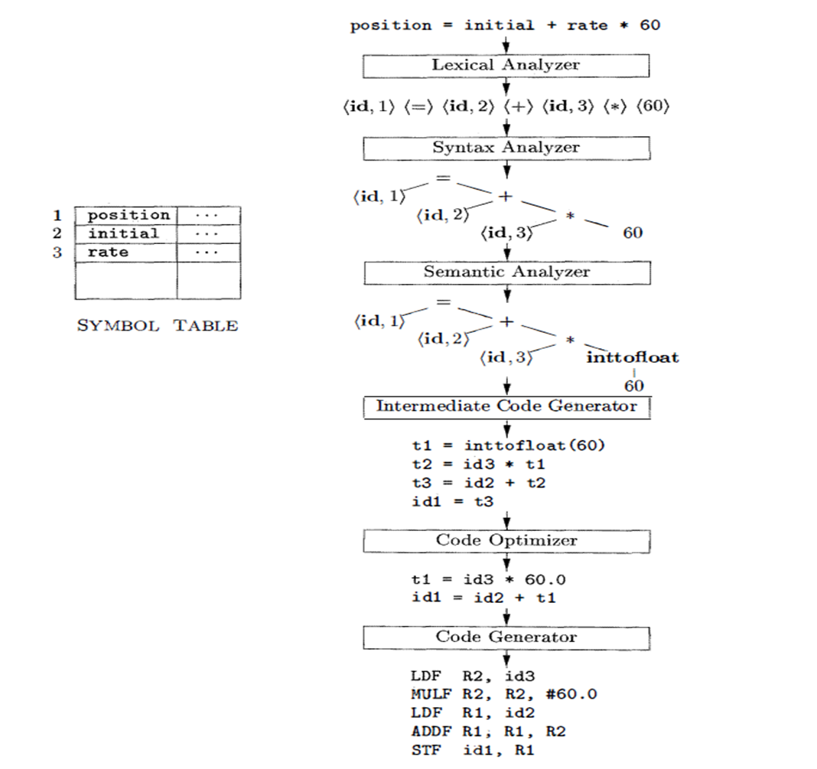

Slide 9
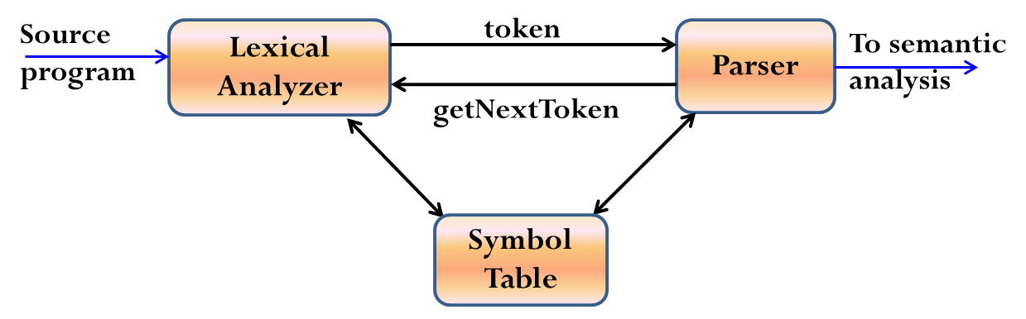
The Role of Lexical Analyzer
It is common for the lexical analyzer to interact with the symbol table.
When the lexical analyzer discovers a lexeme constituting an identifier, it needs to enter that lexeme into the symbol table.
In some cases, information regarding the kind of identifier may be read from the symbol table by the lexical analyzer to assist it in determining the proper token it must pass to the parser.

Slide 10
Other tasks of an LA
Since LA is the part of the compiler that reads the source text, it may perform certain other tasks besides identification of lexemes such as:
Stripping out comments and whitespace (blank, newline, tab, and perhaps other characters that are used to separate tokens in the input).
Correlating error messages generated by the compiler with the source program.
For instance, the LA may keep track of the number of newline characters seen, so it can associate a line number with each error message.
If the source program uses a macro-preprocessor, the expansion of macros may also be performed by the lexical analyzer.
Sometimes, lexical analyzers are divided into a cascade of two processes:
Scanning consists of the simple processes that do not require tokenization of the input, such as deletion of comments and compaction of consecutive whitespace characters into one.
Lexical analysis is the more complex portion, where the scanner produces the sequence of tokens as output (tokenization)

Slide 11
Lexical Analysis versus Parsing
There are a number of reasons why the analysis portion of a compiler is normally separated into lexical analysis and parsing (syntax analysis) phases:
Simplicity of Design:- is the most important consideration that often allows us to simplify compilation tasks.
For example, a parser that had to deal with comments and whitespace as syntactic units would be considerably more complex than one that can assume comments and whitespace have already been removed by the lexical analyzer.
If we are designing a new language, separating lexical and syntactic concerns can lead to a cleaner overall language design.
Compiler efficiency is improved:- a separate lexical analyzer allows us to apply specialized techniques that serve only the lexical task, not the job of parsing.
In addition, specialized buffering techniques for reading input characters can speed up the compiler significantly.
Compiler portability is enhanced:- input-device-specific peculiarities can be restricted to the lexical analyzer.

Slide 12
Tokens, Patterns, and Lexemes
A lexeme is a sequence of characters in the source program that matches the pattern for a token.
Example: -5, i, sum, 100, for ; int 10 + -
Token:- is a pair consisting of a token name and an optional attribute value.
Example:
Identifiers = { i, sum }
int_Constatnt = { 10, 100, -5 }
Opr = { +, -}
rev_Words = { for, int}
Separators = { ;, ,}
One token for each keyword. The pattern for a keyword is the same as the keyword itself.
Tokens for the operators , either individually or in classes such as the token in comparison operators
One token representing all identifiers.
One or more tokens representing constants, such as numbers and literal strings .
Tokens for each punctuation symbol, such as left and right parentheses, comma, and semicolon

Slide 13
Tokens, Patterns, and Lexemes
Pattern is a rule describing the set of lexemes that can represent a particular token in source program
It is a description of the form that the lexemes of a token may take.
In the case of a keyword as a token, the pattern is just the sequence of characters that form the keyword.
For identifiers and some other tokens, the pattern is a more complex structure that is matched by many strings.
One efficient but complex brute-force approach is to read character by character to check if each one follows the right sequence of a token.

Slide 14
Tokens, Patterns, and Lexemes
The below example shows a partial code for this brute-force lexical analyzer.
What we’d like is a set of tools that will allow us to easily create and modify a lexical analyzer that has the same run-time efficiency as the brute-force method.
The first tool that we use to attack this problem is Deterministic Finite Automata (DFA).
if (c = nextchar() == ‘c’) {
if (c = nextchar() == ‘l’) {
/* code to handle the rest of either “class” or any identifier that
starts with “cl” */
} else if (c == ‘a’) {
/* code to handle the rest of either “case” or any identifier that
starts with “ca” */
} else {
/* code to handle any identifier that starts with c */
}
} else if ( c = …..) {
// many more nested ifs for the rest of the lexical analyzer

Slide 15
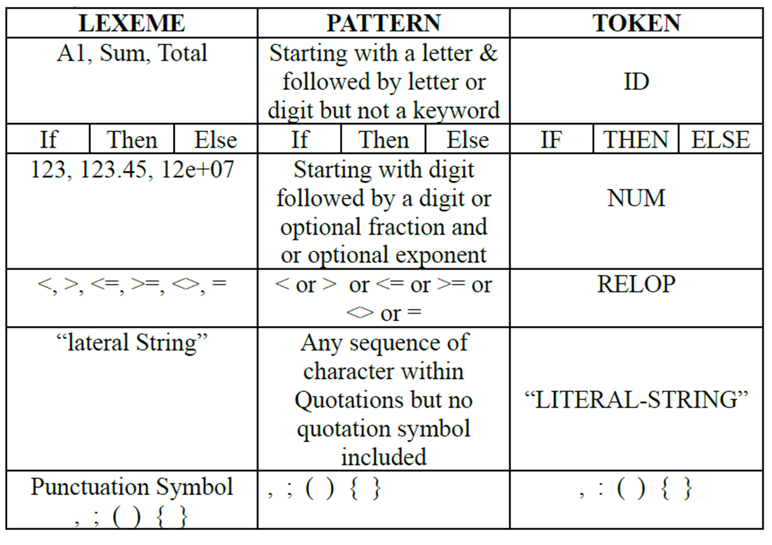
Tokens, Patterns, and Lexemes

Slide 16
Consideration for a simple design of Lexical Analyzer
Lexical Analyzer can allow source program to be
Free-Format Input:- the alignment of lexeme should not be necessary in determining the correctness of the source program, such restriction put extra load on Lexical Analyzer
Blanks Significance:- Simplify the task of identifying tokens
E.g. int a indicates <int is keyword> <a is identifier>
inta indicates <inta is Identifier>
Keyword must be reserved:- Keywords should be reserved otherwise LA will have to predict whether the given lexeme should be treated as a keyword or as identifier
E.g. if then then then = else;
else else = then;
The above statements are misleading as then and else keywords are not reserved.
Approaches to implementation
Use assembly language- Most efficient but most difficult to implement
Use high level languages like C- Efficient but difficult to implement
Use tools like Lex, flex, javacc… Easy to implement but not as efficient as the first two cases

Slide 17
Lexical Errors
Are primarily of two kinds:
Lexemes whose length exceed the bound specified by the language.
Most languages have bound on the precision of numeric constants.
A constant whose bound exceeds this bound is a lexical error.
Illegal character in the program
Characters like ∼, ∀, ©, ® occurring in a given programming language (but not within a string or comment) are lexical errors.
Unterminated strings or comments.

Slide 18
Handling Lexical Errors
It is hard for a LA to tell, without the aid of other components, that there is a source-code error.
For instance, if the string fi is encountered for the first time in a java program in the context: fi(a == 2*4+3) a lexical analyzer cannot tell whether fi is a misspelling of the keyword if or an undeclared function identifier.
However, suppose a situation arises in which the lexical analyzer is unable to proceed because none of the patterns for tokens matches any prefix of the remaining input.
The simplest recovery strategy is "panic mode" recovery.
We delete successive characters from the remaining input, until the lexical analyzer can find a well-formed token at the beginning of what input is left.
This recovery technique may confuse the parser, but in an interactive computing environment it may be quite adequate.

Slide 19
Handling Lexical Errors
Other possible error-recovery actions are:
Insert a missing character into the remaining input.
Replacing an incorrect character by a correct character
Transpose two adjacent characters (such as , fi => if).
Deleting an extraneous character
Pre-scanning

Slide 20
Input Buffering
There are some ways that the task of reading the source program can be speed up
This task is made difficult by the fact that we often have to look one or more characters beyond the next lexeme before we can be sure we have the right lexeme
In C language: we need to look after -, = or < to decide what token to return
We shall introduce a two-buffer scheme that handles large look-aheads safely
We then consider an improvement involving sentinels that saves time checking for the ends of buffers
Because of the amount of time taken to process characters and the large number of characters that must be processed during compilation of a large source program,
specialized buffering techniques have been developed to reduce the amount of overhead to process a single input character
An important scheme involves two buffers that are alternatively reloaded, as shown in the Figure next slide

Slide 21
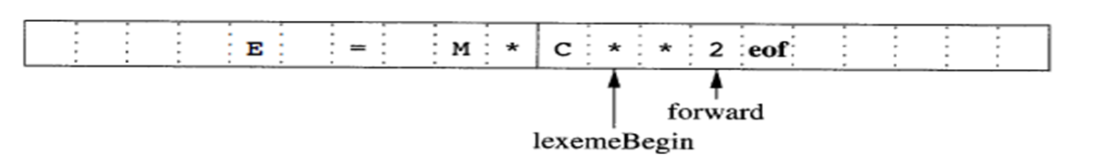
Input Buffering
Each buffer is of the same size N, and N is usually the size of a disk block, e.g., 4096 bytes
Using one system read command we can read N characters into a buffer, rather than using one system call per character
If fewer than N characters remain in the input file, then a special character, represented by eof, marks the end of the source file and is different from any possible character of the source program
Two pointers to the input are maintained:
Pointer lexemeBegin, marks the beginning of the current lexeme, whose extent we are attempting to determine
Pointer forward scans ahead until a pattern match is found

Slide 22
Input Buffering
Once the lexeme is determined, forward is set to the character at its right end (involves retracting)
Then, after the lexeme is recorded as an attribute value of the token returned to the parser, lexemeBegin is set to the character immediately after the lexeme just found
Advancing forward requires that we first test whether we have reached the end of one of the buffers, and if so, we must reload the other buffer from the input, and move forward to the beginning of the newly loaded buffer
Sentinels
If we use the previous scheme, we must check each time we advance forward, that we have not moved off one of the buffers; if we do, then we must also reload the other buffer
Thus, for each character read, we must make two tests: one for the end of the buffer, and one to determine which character is read
We can combine the buffer-end test with the test for the current character if we extend each buffer to hold sentinel character at the end

Slide 23
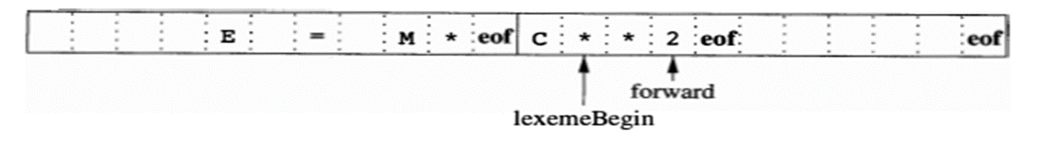
Input Buffering
The sentinel is a special character that cannot be part of the source program, and a natural choice is the character eof
Note that eof retains its use as a marker for the end of the entire input
Any eof that appears other than at the end of buffer means the input is at an end
The above Figure shows the same arrangement as Figure in slide no. 21, but with the sentinels added.
Fig. Sentinels at the end of each buffer
Switch (*forward++) {
case eof:
if (forward is at end of first buffer) {
reload second buffer;
forward = beginning of second buffer;
}
else if {forward is at end of second buffer) {
reload first buffer;
forward = beginning of first buffer;
}
else /*eof within buffer marks the end of input */
terminate lexical analysis;
break;
cases for the other characters;
}

Slide 24
Specification of Tokens
Regular expressions are an important notation for specifying lexeme patterns.
While they cannot express all possible patterns, they are very effective in specifying those types of patterns that we actually need for tokens.
In theory of compilation regular expressions are used to formalize the specification of tokens
Regular expressions are means for specifying regular languages
Strings and Languages
An alphabet is any finite set of symbols. Typical examples of symbols are let­ters, digits, and punctuation.
The set {0, 1 } is the binary alphabet.
ASCII is an important example of an alphabet; it is used in many software systems.
Unicode, which includes approximately 100,000 characters from alphabets around the world, is another important example of an alphabet.

Slide 25
Specification of Tokens
A string over an alphabet is a finite sequence of symbols drawn from that alphabet.
In language theory, the terms "sentence" and "word" are often used as synonyms for "string"
The length of a string s, usually written |s|, is the number of occurrences of symbols in s.
For example, banana is a string of length six.
The empty string, denoted Ɛ, is the string of length zero.
A language is any countable set of strings over some fixed alphabet.
Abstract languages like φ , the empty set, or {Ɛ} , the set containing only the empty string, are languages under this definition.
So too are the set of all syntactically well-formed java/c/c⁺⁺ programs and the set of all grammatically correct English sentences, although the latter two languages are difficult to specify exactly.
Note that the definition of "language" does not require that any “meaning” be ascribed to the strings in the language.

Slide 26
Specification of Tokens
Terms for Parts of String
The following string-related terms are commonly used:
A prefix of string S is any string obtained by removing zero or more symbols from the end of S.
For example, ban, banana, and Ɛ are prefixes of banana.
A suffix of string S is any string obtained by removing zero or more symbols from the beginning of S.
For example, nana, banana, and Ɛ are suffixes of banana.
A substring of S is obtained by deleting any prefix and any suffix from S.
For instance, banana, nan, and Ɛ are substrings of banana.
The proper prefixes, suffixes, and substrings of a string S are those, prefixes, suffixes, and substrings, respectively, of S that are not Ɛ or not equal to S itself.
A subsequence of S is any string formed by deleting zero or more not necessarily consecutive positions of S.
For example, baan is a subsequence of banana.

Slide 27
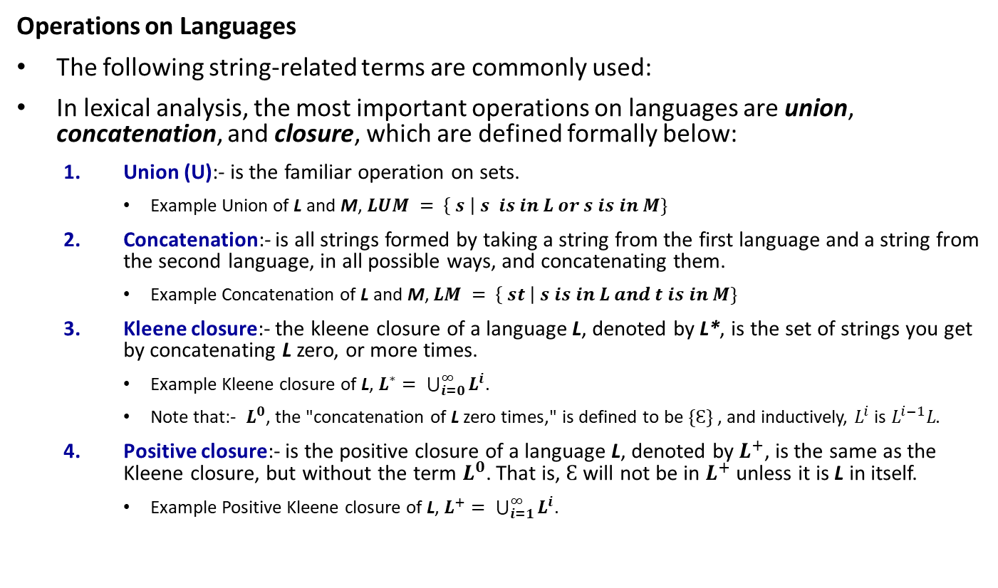
Specification of Tokens
Operations on Languages
The following string-related terms are commonly used:
In lexical analysis, the most important operations on languages are union, concatenation, and closure, which are defined formally below:
Union (U):- is the familiar operation on sets.
Example Union of L and M, $LUM = \left\{ s \right| s is in L or s is in M\}$
Concatenation:- is all strings formed by taking a string from the first language and a string from the second language, in all possible ways, and concatenating them.
Example Concatenation of L and M, $LM = \left\{ st \right| s is in L and t is in M\}$
Kleene closure:- the kleene closure of a language L, denoted by L*, is the set of strings you get by concatenating L zero, or more times.
Example Kleene closure of L, $L^{∗}= \bigcup_{i=0}^{∞}{L^{i}}$.
Note that:- $L^{0}$, the "concatenation of L zero times," is defined to be $\{Ɛ\}$ , and inductively, $L^{i}$ is $L^{i−1}L$.
Positive closure:- is the positive closure of a language L, denoted by $L^{+}$, is the same as the Kleene closure, but without the term $L^{0}$. That is, $Ɛ$ will not be in $L^{+}$ unless it is L in itself.
Example Positive Kleene closure of L, $L^{+}= \bigcup_{i=1}^{∞}{L^{i}}$.

Slide 28
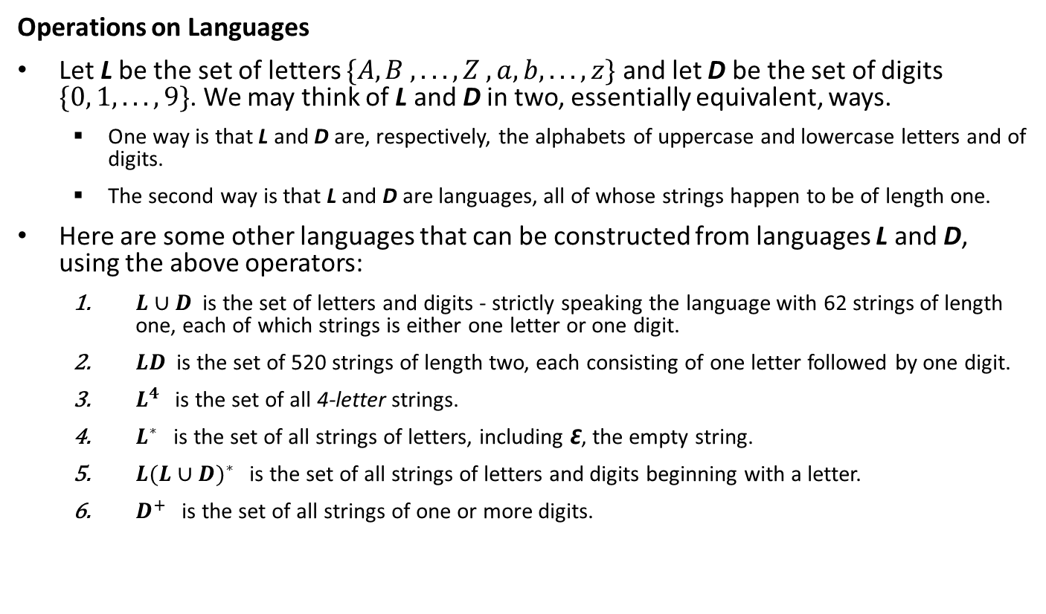
Specification of Tokens
Operations on Languages
Let L be the set of letters $\{A, B , . . . , Z , a, b, . . . , z\}$ and let D be the set of digits $\{0, 1, . . ., 9\}$. We may think of L and D in two, essentially equivalent, ways.
One way is that L and D are, respectively, the alphabets of uppercase and lowercase letters and of digits.
The second way is that L and D are languages, all of whose strings happen to be of length one.
Here are some other languages that can be constructed from languages L and D, using the above operators:
$L∪D$ is the set of letters and digits - strictly speaking the language with 62 strings of length one, each of which strings is either one letter or one digit.
$LD$ is the set of 520 strings of length two, each consisting of one letter followed by one digit.
$L^{4}$is the set of all 4-letter strings.
$L^{∗}$ is the set of all strings of letters, including Ɛ, the empty string.
$L{(L∪D)}^{∗}$ is the set of all strings of letters and digits beginning with a letter.
$D^{+}$ is the set of all strings of one or more digits.

Slide 29
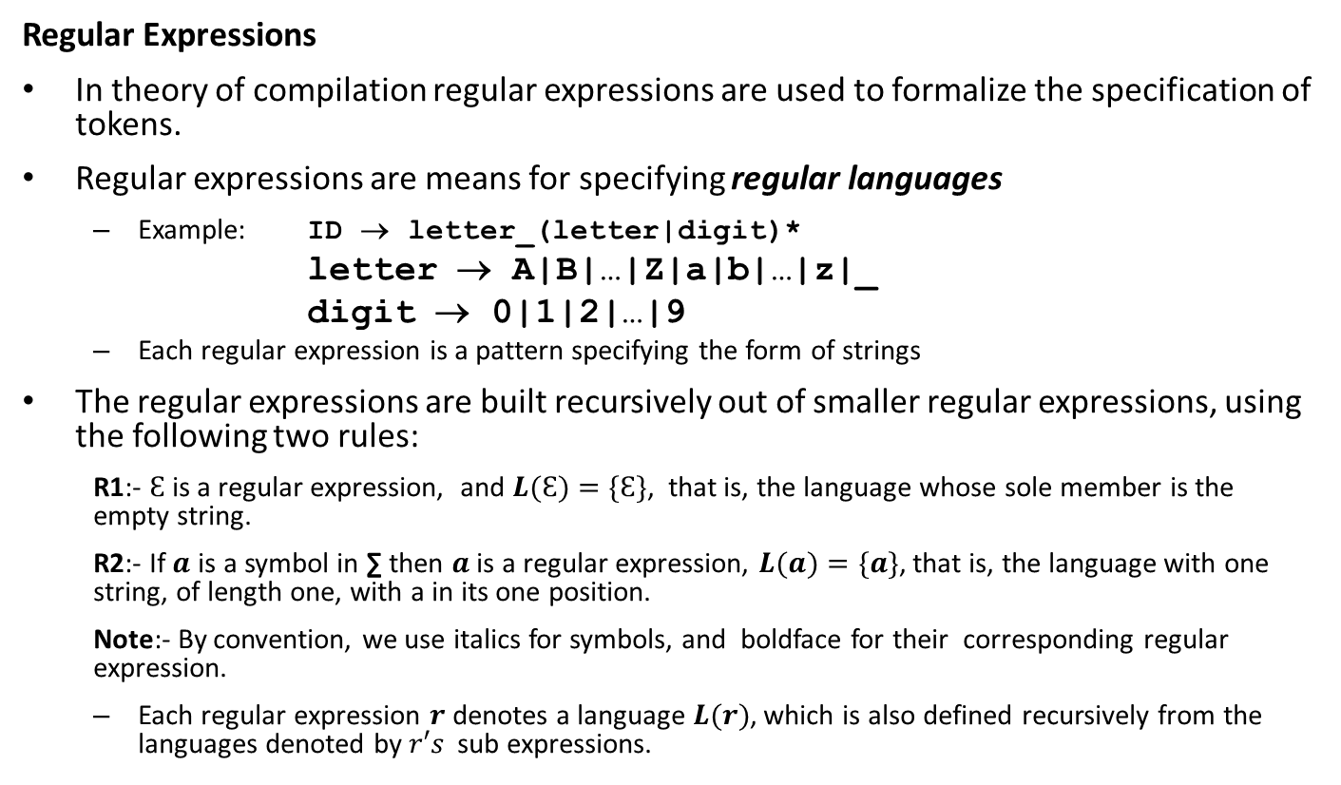
Specification of Tokens
Regular Expressions
In theory of compilation regular expressions are used to formalize the specification of tokens.
Regular expressions are means for specifying regular languages
Example: ID → letter_(letter|digit)*
letter → A|B|…|Z|a|b|…|z|_
digit → 0|1|2|…|9
Each regular expression is a pattern specifying the form of strings
The regular expressions are built recursively out of smaller regular expres­sions, using the following two rules:
R1:- $Ɛ$ is a regular expression, and $L(Ɛ)=\{Ɛ\}$, that is, the language whose sole member is the empty string.
R2:- If $a$ is a symbol in ∑ then $a$is a regular expression, $L(a)=\{a\}$, that is, the language with one string, of length one, with a in its one position.
Note:- By convention, we use italics for symbols, and boldface for their corresponding regular expression.
Each regular expression $r$ denotes a language $L(r)$, which is also defined recursively from the languages denoted by $r′s$sub expressions.

Slide 30
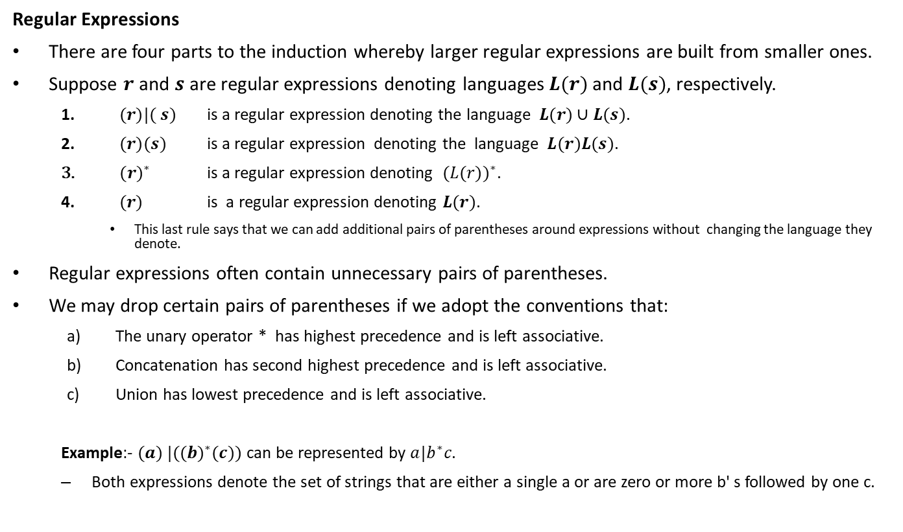
Specification of Tokens
Regular Expressions
There are four parts to the induction whereby larger regular expressions are built from smaller ones.
Suppose $r$ and $s$ are regular expressions denoting languages $L(r)$ and $L(s)$, respectively.
$(r)|( s)$ is a regular expression denoting the language $L(r)∪L(s)$.
$(r)(s)$ is a regular expression denoting the language $L(r)L(s)$.
${(r)}^{∗}$ is a regular expression denoting ${(L(r))}^{∗}$.
$(r)$ is a regular expression denoting $L(r)$.
This last rule says that we can add additional pairs of parentheses around expressions without changing the language they denote.
Regular expressions often contain unnecessary pairs of parentheses.
We may drop certain pairs of parentheses if we adopt the conventions that:
The unary operator * has highest precedence and is left associative.
Concatenation has second highest precedence and is left associative.
Union has lowest precedence and is left associative.
Example:- $(a) |({(b)}^{∗}(c))$ can be represented by $a|b^{∗}c$.
Both expressions denote the set of strings that are either a single a or are zero or more b' s followed by one c.

Slide 31
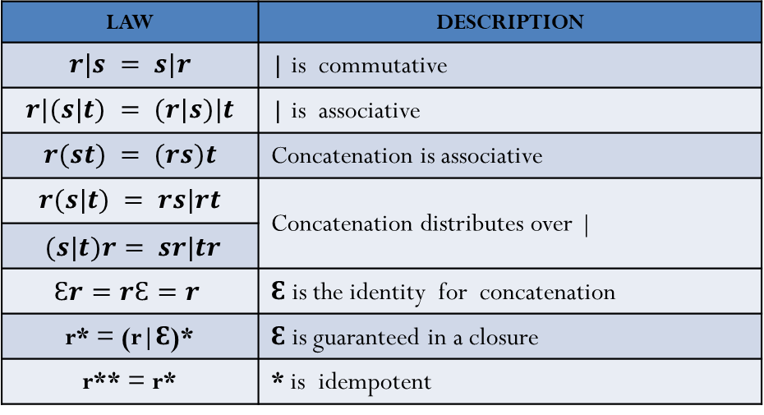

Specification of Tokens
Regular Expressions
A language that can be defined by a regular expression is called a regular set.
If two regular expressions $r$ and $s$ denote the same regular set, we say they are equivalent and write $r=s$.
For instance, $\left(a | b\right)=(b|a)$.
There are a number of algebraic laws for regular expressions; each law asserts that expressions of two different forms are equivalent.
LAW | DESCRIPTION
$$r|s = s|r$$ | | is commutative
$$r|(s|t) = (r|s)|t$$ | | is associative
$$r(st) = (rs)t$$ | Concatenation is associative
$$r(s|t) = rs|rt$$ | Concatenation distributes over |
$(s|t)r= sr|tr$
$$Ɛr=rƐ=r$$ | Ɛ is the identity for concatenation
r* = (r|Ɛ)* | Ɛ is guaranteed in a closure
r** = r* | * is idempotent
Table: The algebraic laws that hold for arbitrary regular expressions r, s, and t.

Slide 32
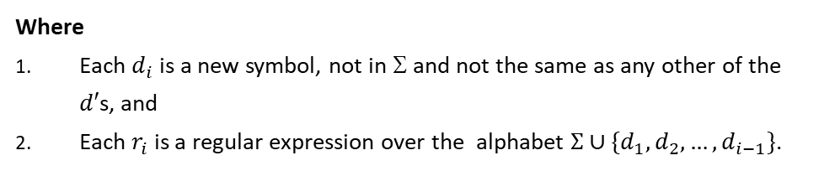

Specification of Tokens
Regular Definitions
If Σ is an alphabet of basic symbols, then a regular definition is a sequence of definitions of the form :
$$d_{1}  r_{1}$$
$$d_{2}  r_{2}$$
…
$$d_{n}  r_{n}$$
Examples
Regular definition for C⁺⁺ identifiers:
ID → letter(letter|digit)*
letter → A|B|…|Z|a|b|…|z|_
digit → 0|1|2|…|9
Where
Each $d_{i}$is a new symbol, not in Σ and not the same as any other of the $d′$s, and
Each $r_{i}$ is a regular expression over the alphabet $Σ∪\{d_{1},d_{2}, …,d_{i−1}\}$.
b) Regular definition for C++ statements
stmt → if expr then stmt
| if expr then stmt else stmt
| Ɛ
expr → term relop term
| term
term → id
| number
c) Regular Definition for unsigned numbers such as 5280, 0.0 1 234, 6. 336E4, or 1. 89E-4
digit →0|1|2|…|9
digits →digit digit*
optFrac→ . digts|Ɛ
optExp→ (E(+|-|Ɛ) digts|Ɛ
number → digits optFrac OptExp

Slide 33
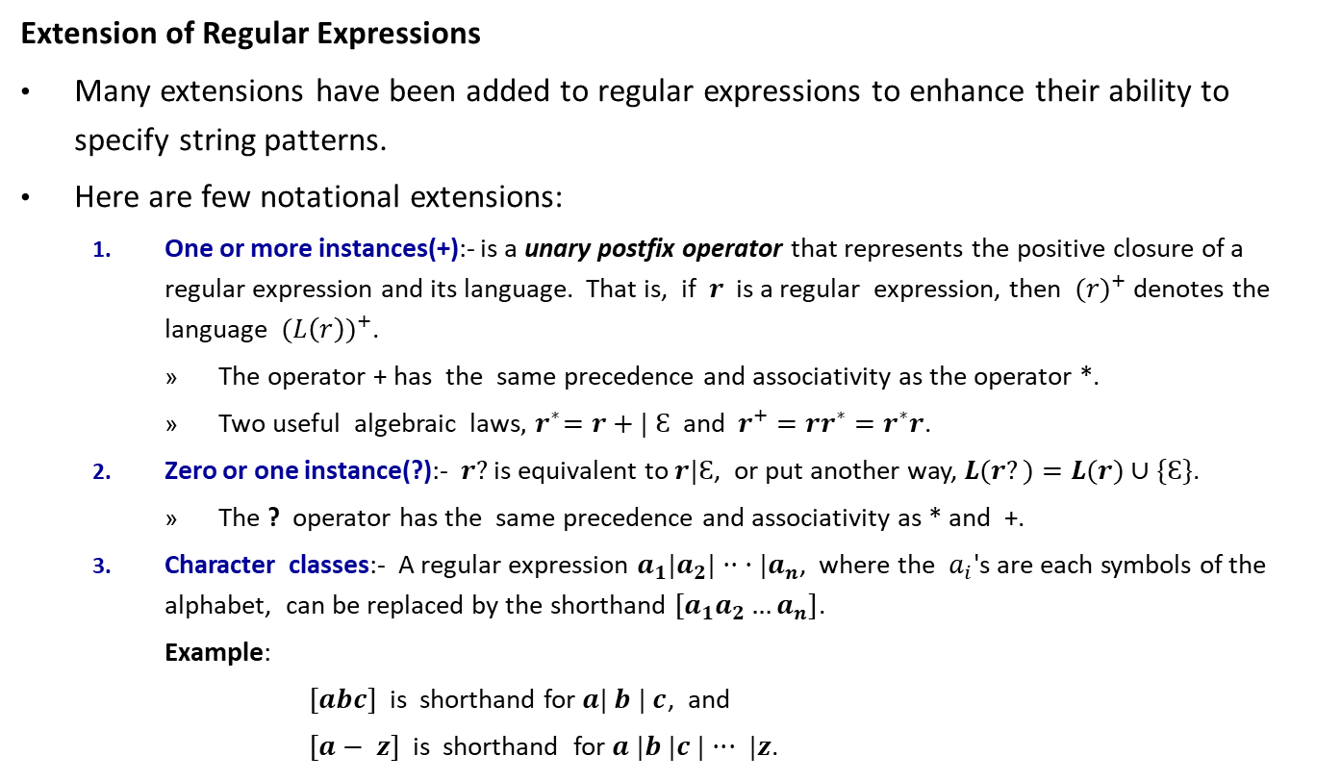
Specification of Tokens
Extension of Regular Expressions
Many extensions have been added to regular expressions to enhance their ability to specify string patterns.
Here are few notational extensions:
One or more instances(+):- is a unary postfix operator that represents the positive closure of a regular expression and its language. That is, if $r$ is a regular expression, then ${(r)}^{+}$denotes the language ${(L\left(r\right))}^{+}$.
The operator + has the same precedence and associativity as the operator *.
Two useful algebraic laws$, { r}^{∗}=r+| Ɛ$ and $r^{+}=rr^{∗}=r^{∗}r$.
Zero or one instance(?):- $r?$ is equivalent to $r|Ɛ$, or put another way, $L(r?)=L(r)∪\{Ɛ\}$.
The ? operator has the same precedence and associativity as * and +.
Character classes:- A regular expression $a_{1}|a_{2}|·· ·|a_{n}$, where the $a_{i}$'s are each symbols of the alphabet, can be replaced by the shorthand $[a_{1}a_{2}…a_{n}]$.
Example:
$[abc]$is shorthand for $a| b | c$, and
$[a− z]$is shorthand for $a |b |c |··· |z$.

Slide 34
Specification of Tokens
Extension of Regular Expressions
Using the above short hands we can rewrite the regular expression for examples a) and c) in slide number 32 as follows:
Examples
a) Regular definitions for C⁺⁺ identifiers
ID → letter(letter|digit)*
letter →[A-Za-z_]
digit →[0-9]
c) Regular Definition for unsigned numbers such as 5280 , 0.0 1 234, 6. 336E4, or 1. 89E-4
digit →[0-9]
digits →digit⁺
number → digits (. digits)? (E [+ -]? digits)?

Slide 35
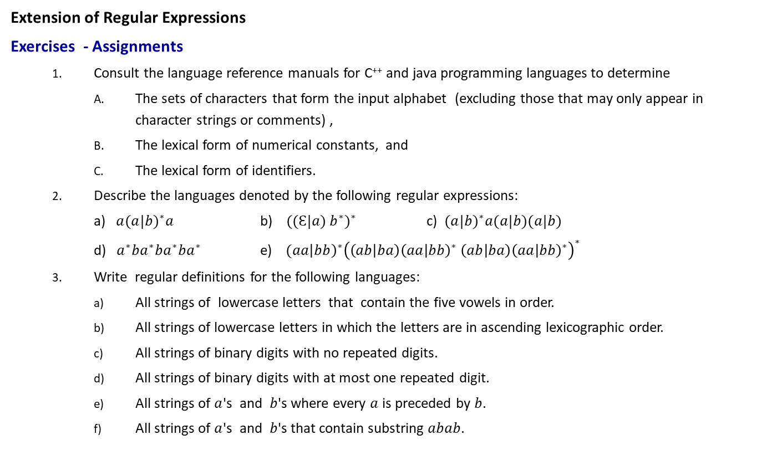
Specification of Tokens
Extension of Regular Expressions
Exercises - Assignments
Consult the language reference manuals for C⁺⁺ and java programming languages to determine
The sets of characters that form the input alphabet (excluding those that may only appear in character strings or comments) ,
The lexical form of numerical constants, and
The lexical form of identifiers.
Describe the languages denoted by the following regular ex­pressions:
a) ${a(a|b)}^{∗}a$ b) ${ ((Ɛ|a) b^{∗})}^{∗}$ c) ${ (a|b)}^{∗}a(a|b)(a|b)$
d) ${ a}^{∗}ba^{∗}ba^{∗}ba^{∗}$ e) $({aa\left|bb\right)}^{∗}{\left(\left(ab | ba\right){\left(aa | bb\right)}^{∗} \left(ab | ba\right){\left(aa | bb\right)}^{∗}\right)}^{∗}$
Write regular definitions for the following languages:
All strings of lowercase letters that contain the five vowels in order.
All strings of lowercase letters in which the letters are in ascending lexicographic order.
All strings of binary digits with no repeated digits.
All strings of binary digits with at most one repeated digit.
All strings of $a$'s and $b$'s where every $a$ is preceded by $b$.
All strings of $a$'s and $b$'s that contain substring $abab$.

Slide 36
Recognition of Tokens
Regular definitions, a mechanism based on regular expressions are very popular for specification of tokens.
Has been implemented in the lexical analyzer generator tool, LEX.
In our lab session, we will see token specification using LEX.
Transition diagrams, a variant of finite state automata, are used to implement regular definitions and to recognize tokens.
Transition diagrams are usually used to model a Lexical Analyzer before translating them to programs by hand.
LEX automatically generates optimized FSA from regular definitions
We studied FSA and their generation from regular expressions, then we will see the relation between transition diagrams and LEX.

Slide 37
Recognition of Tokens
Transition Diagrams
Transition diagrams are generalized DFAs with the following differences
Edges may be labelled by a symbol, a set of symbols, or a regular definition.
Some accepting states may be indicated as retracting states, indicating that the lexeme does not include the symbol that brought us to the accepting state.
Each accepting state has an action attached to it, which is executed when that state is reached. Typically, such an action returns a token and its attribute value.
Transition diagrams are not meant for machine translation but only for manual translation.

Slide 38
Recognition of Tokens
Starting point is the language grammar to understand the tokens:
stmt → if expr then stmt
| if expr then stmt else stmt
| Ɛ
expr → term relop term
| term
term → id
| number
The next step is to formalize the patterns:
digit → [0-9]
Digits → digit+
number → digit(.digits)? (E[+-]? Digit)?
letter → [A-Za-z_]
id → letter (letter|digit)*
If → if
Then → then
Else → else
Relop → < | > | <= | >= | = | <>
We also need to handle whitespaces:
ws → (blank | tab | newline⁾⁺

Slide 39
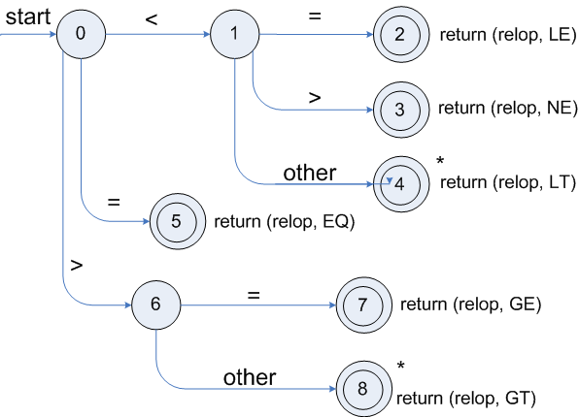
Recognitions of Tokens
To understand the recognition of tokens, consider the regular expression of tokens, together with attribute values
Lexemes | Token Names | Attribute Value
Any ws | - | -
if | if | -
then | then | -
else | else | -
Any id | id | Pointer to table entry
Any number | number | Pointer to table entry
< | relop | LT
<= | relop | LE
= | relop | EQ
<> | relop | NE
> | relop | GT
>= | relop | GE
Transition diagram for relop

Slide 40
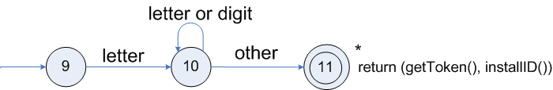
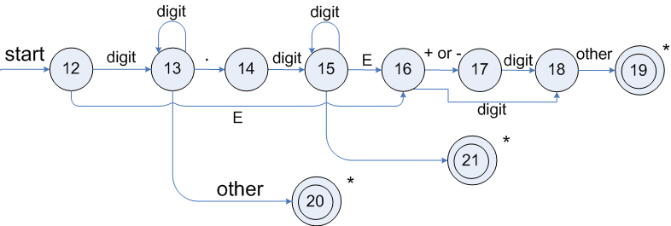
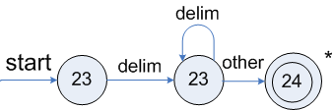
Recognitions of Tokens
Transition diagram Transition diagram for reserved words and identifiers:
Transition diagram for unsigned numbers:
Transition diagram for white spaces where delim represents one or more whitespace characters:
‘*’ indicates the retraction state.
getToken() searches a table to check if the name is a reserved word and returns its integer code if so.

Slide 41
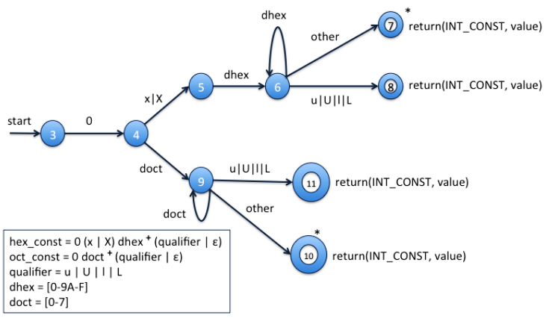
Recognitions of Tokens
In a similar way, transition diagrams for other program constructs can be designed as follows:
For hexadecimal and octal constants:

Slide 42
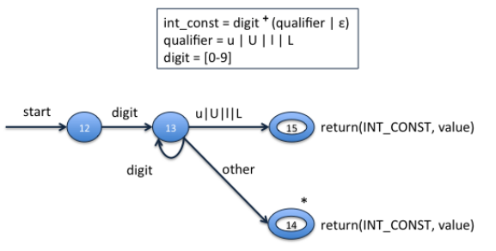
Recognitions of Tokens
For Integer constants:

Slide 43
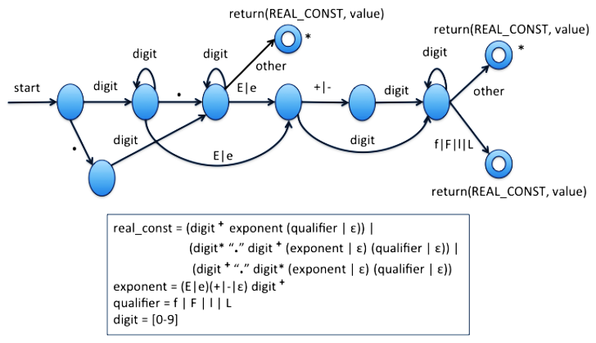
Recognitions of Tokens
For Real constants:

Slide 44
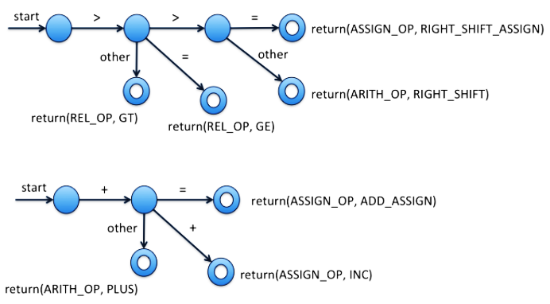
Recognitions of Tokens
For a few operators:

Slide 45
Combining TDs to form Lexical Analyzer
Different transition diagrams must be combined appropriately to yield a Lexical Analyzer.
Combining TDs is not trivial
It is possible to try different transition diagrams one after another
For example, TDs for reserved words, constants, identifiers, and operators could be tried in that order
However, this does not use the “longest match" characteristic (the next would be an identifier, and not reserved word then followed by identifier ext)
To find the longest match, all TDs must be tried and the longest match must be used
Using LEX to generate a lexical analyzer makes it easy for the compiler writer

Slide 46
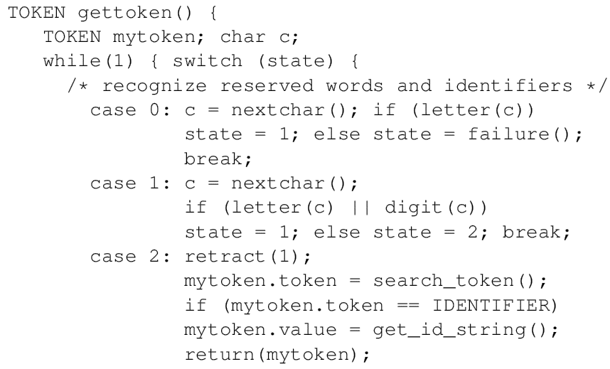
Lexical Analyzer Implementation for TDs
The following code can be constructed by combining the transition diagrams:

Slide 47
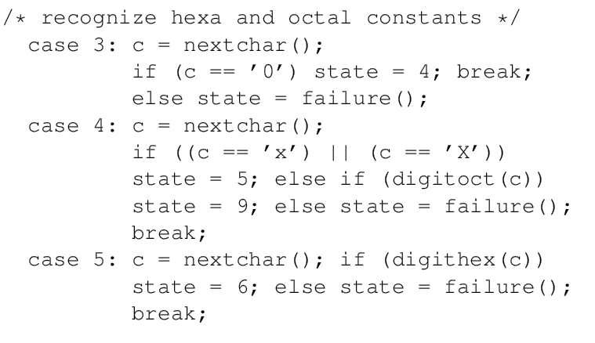
Lexical Analyzer Implementation for TDs

Slide 48
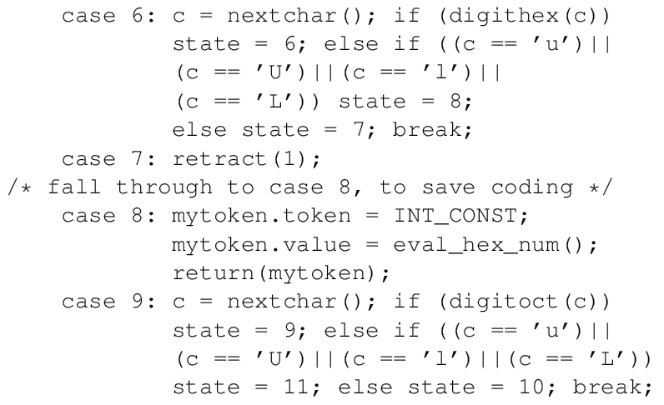
Lexical Analyzer Implementation for TDs

Slide 49
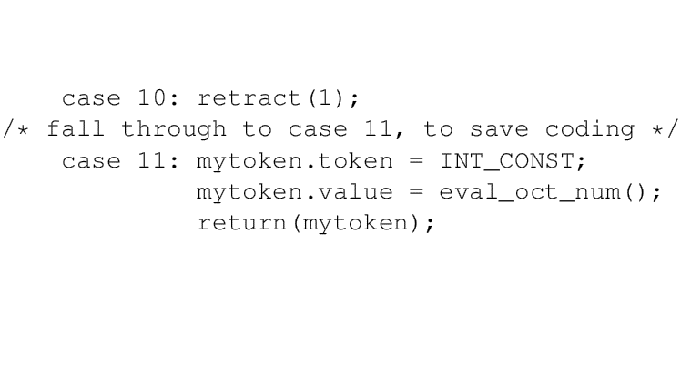
Lexical Analyzer Implementation for TDs

Slide 50
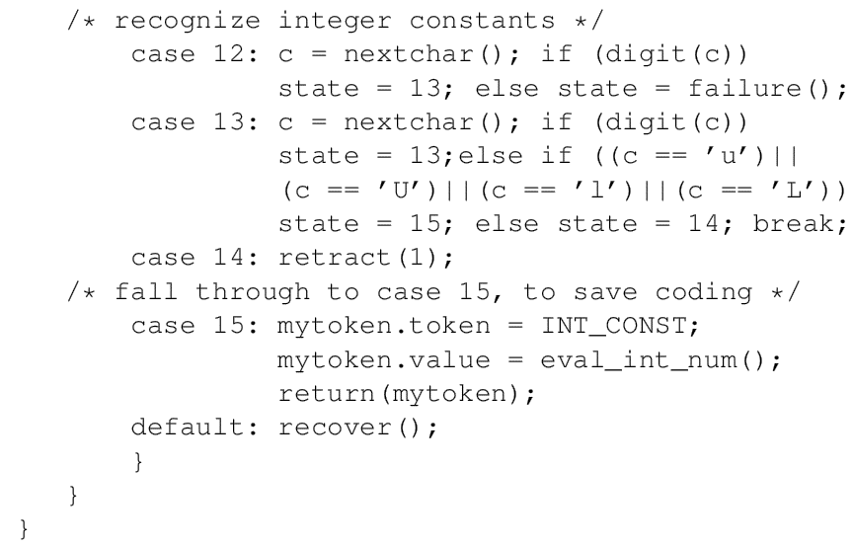
Lexical Analyzer Implementation for TDs

Slide 51
Introduction to Lex A lexical analyzer generator tool

Slide 52
Introduction to Lex
LEX – is pattern-action language / pattern directed programming used for specifying lexical analyzers.
LEX has a language for describing regular expressions
It generates a pattern matcher for the regular expression specifications provided to it as input.
General structure of a LEX program is:
{definitions} Optional
%%
{rules} Essential
%%
{user subroutines} Essential
Commands to create an LA
lex ex.l – creates a C-program lex.yy.c
gcc -o ex.o lex.yy.c – produces ex.o
ex.o is a lexical analyzer, that carves tokens from its input

Slide 53
Introduction to Lex
Lex Example 1: LEX specification for the recognizing Capital Letter
/* no definition sectin */
%%
[A-Z]+ { ECHO; printf("\n"); }
.|\n ;
%%
yywrap(){}
main(){
yylex();
}
Rule section
Subroutine section
/* Output */
WEUFWIG
H
H
SDWE
T
FL
T
/* Input */
wewevWEUFWIGhHkkH
sdcwehSDWEhTkFLksewT

Slide 54
Introduction to Lex
Lex – Definition Section
contains definitions and included code.
Definitions are like macros and have the following form:
name translation
digit [0-9]
number {digit}{digit}*
Included code is all code included between %{ and %}:
%{
float number; int count=0;
%}

Slide 55
Introduction to Lex
Lex – Rule Section
Contains patterns and C-code
A line starting with white space or material enclosed in %{ and %} is a C-code.
A line starting with anything else is a pattern line.
Pattern lines contain a pattern followed by some white space and C-code:
{ pattern } { action (C − code) }
C-code lines are copied verbatim to the generated C-file (lex.yy.c).
Patterns are translated into NFA which are then converted into DFA, optimized, and stored in the form of a state table and a driver routine.
The action associated with a pattern is executed when the DFA recognizes a string corresponding to that pattern and reaches a final state.

Slide 56
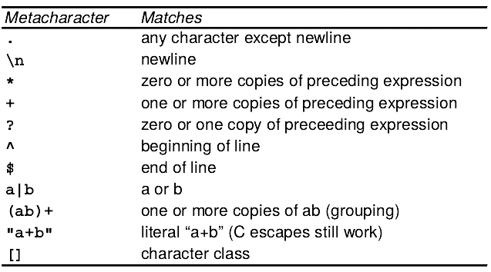
Introduction to Lex
Lex – Metacharacters and Matches
Regular expressions in lex are composed of metacharacters.
Pattern Matching Primitives

Slide 57
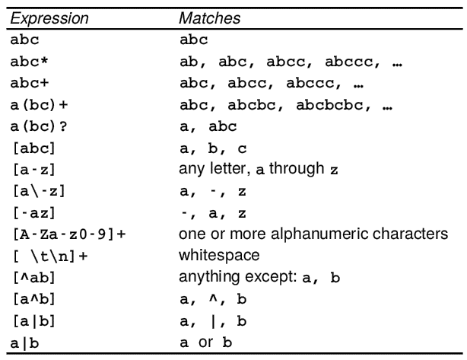
Introduction to Lex
Lex – Metacharacters and Matches
Pattern matching example:

Slide 58
Lex – Strings and Operators
Examples of strings: integer a57d hello
Operators: " \ [] ^ - ? . * + | () $ {} % <>
\ (backslash) can be used as an escape character as in C
Character classes: enclosed in [ and ]
Only \, -, and ^ are special inside [ ].
All other operators are irrelevant inside [ ].
Examples:
[-+][0-9]+ –--> (-|+)(0|1|2|3|4|5|6|7|8|9)+
[a-d][0-4][A-C] ---> a|b|c|d|0|1|2|3|4|A|B|C
[^abc] ---> all char except a, b, or c, including special and control char.
[+\-][0-5]+ ---> (+|-)(0|1|2|3|4|5)+
[^a-zA-Z] ---> all char which are not letters

Slide 59
Lex – Strings and Operators
The . operator: matches any character except newline.
The ? operator: used to implement option ab?c stands for a(b|ε)c
Repetition, alternation, and grouping:
Example: (ab|cd+)?(ef)∗ —--> (ab|c(d)+ | ε )(ef)∗
Context sensitivity: /, ^, $, are context-sensitive operators
^ : If the first char of an expression is ^, then that expression is matched only at the beginning of a line. Holds only outside [] operator.
$ : If the last char of an expression is $, then that expression is matched only at the end of a line.
/ : Look ahead operator, indicates trailing context.
Examples:
^ab ---> line beginning with ab
ab$ ---> line ending with ab (same as ab/\n)
DO/({letter}|{digit})* = ({letter}|{digit})*

Slide 60
Lex – Actions
Default action is to copy input to output those characters which are unmatched.
We need to provide patterns to catch characters.
yytext: contains the text matched against a pattern
copying yytext can be done by the action ECHO
yyleng: provides the number of characters matched.
LEX always tries the rules in the order written down and the longest match is preferred
Example:
%%
integer action1;
[a-z]+ action2;
%%
The input integers will match the second pattern & action2 will be performed.

Slide 61
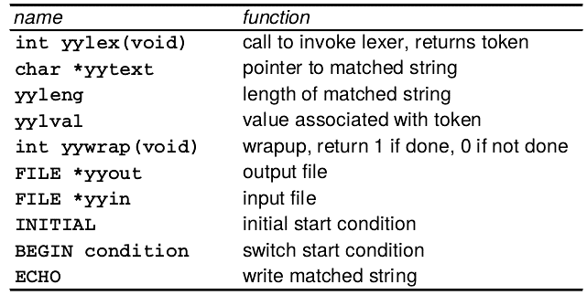
Lex – Actions
Lex Predefined Variables

Slide 62
Lex – Examples
Example 2:number of lines
%%
^[ ]*\n
\n {ECHO; yylineno++;}
.* {printf("%d\t%s",yylineno,yytext);}
%%
yywrap(){}
main(){
yylineno = 1;
yylex();
}

Slide 63
Lex – Examples
Example 3: declaration statements
%{
FILE *declfile;
%}
Blanks [ \t]*
Letter [a-z]
Digit [0-9]
id ({letter}|_)({letter}|{digit}|_)*
number {digit}+
arraydeclpart {id}"["{number}"]"
declpart ({arraydeclpart}|{id})
decllist ({declpart}{blanks}","{blanks})*{blanks}{declpart}{blanks}
declaration (("int")|("float")){blanks}{decllist}{blanks};
%%
{declaration} fprintf(declfile,"%s\n",yytext);
%%
yywrap(){ fclose(declfile); }
main(){ declfile = fopen("declfile","w"); yylex(); }

Slide 64
Lex – Examples
Example 4:Identifier, Reserved words, and constants
%{
int hex = 0; int oct = 0; int regular =0;
%}
letter [a-zA-Z_]
digit [0-9]
digits {digit}+
digit_oct [0-7]
digit_hex [0-9A-F]
int_qualifier [uUlL]
blanks [ \t]+
identifier {letter}({letter}|{digit})*
integer {digits}{int_qualifier}?
hex_const 0[xX]{digit_hex}+{int_qualifier}?
oct_const 0{digit_oct}+{int_qualifier}?

Slide 65
Lex – Examples
Example 4: Identifier, Reserved words, and constants
%%
if {printf("reserved word:%s\n",yytext);}
else {printf("reserved word:%s\n",yytext);}
while {printf("reserved word:%s\n",yytext);}
switch {printf("reserved word:%s\n",yytext);}
{identifier} {printf("identifier :%s\n",yytext);}
{hex_const} {sscanf(yytext,"%i",&hex); printf("hex
constant:%s = %i\n",yytext,hex);}
{oct_const} {sscanf(yytext,"%i",&oct); printf("oct
constant:%s = %i\n",yytext,oct);}
{integer} {sscanf(yytext,"%i",&regular); printf(
“integer :%s = %i\n",yytext, regular);}
.|\n ;
%%
yywrap(){}
int main(){yylex();}

Slide 66
Lex – Examples
Example 5: Floats in c
digits [0-9]+
exp ([Ee](\+|\-)?{digits})
blanks [ \t\n]+
float_qual [fFlL]
%%
{digits}{exp}{float_qual}?/{blanks}
{printf("float no fraction: %s\n",yytext);}
[0-9]*\.{digits}{exp}?{float_qual}?/{blanks}
{printf("float with optionalinteger part:
%s\n",yytext);}
{digits}\.[0-9]*{exp}?{float_qual}?/{blanks}
printf("float with optional fraction:
%s\n",yytext);}
.|\n ;
%%
yywrap(){}
int main(){yylex();}

Slide 67
End of CH2!
Thank You!
Any Questions…?

